Slide 1

MANAGEMENT OF NATURAL RESOURCES
Ganga Action Plan

Slide 2


This multi-crore project came about in 1985 because the quality of the water in the Ganga was very poor.

Slide 3

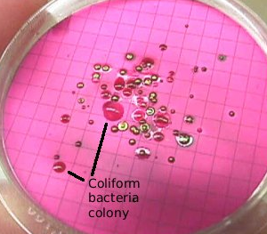
Coliform is a group of bacteria, found in human intestines, whose presence in water indicates contamination by disease-causing microorganisms.
Intestines

Slide 4
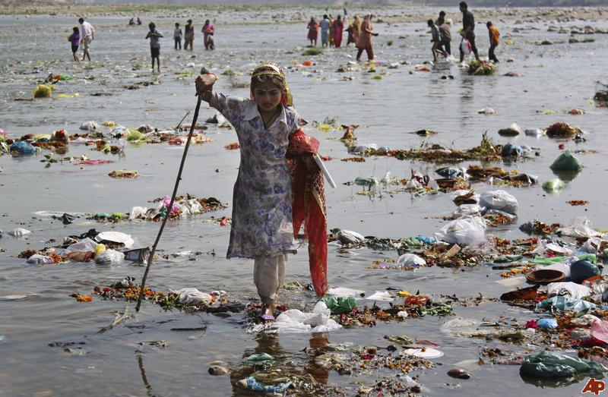
Pollution of the Ganga

Slide 5
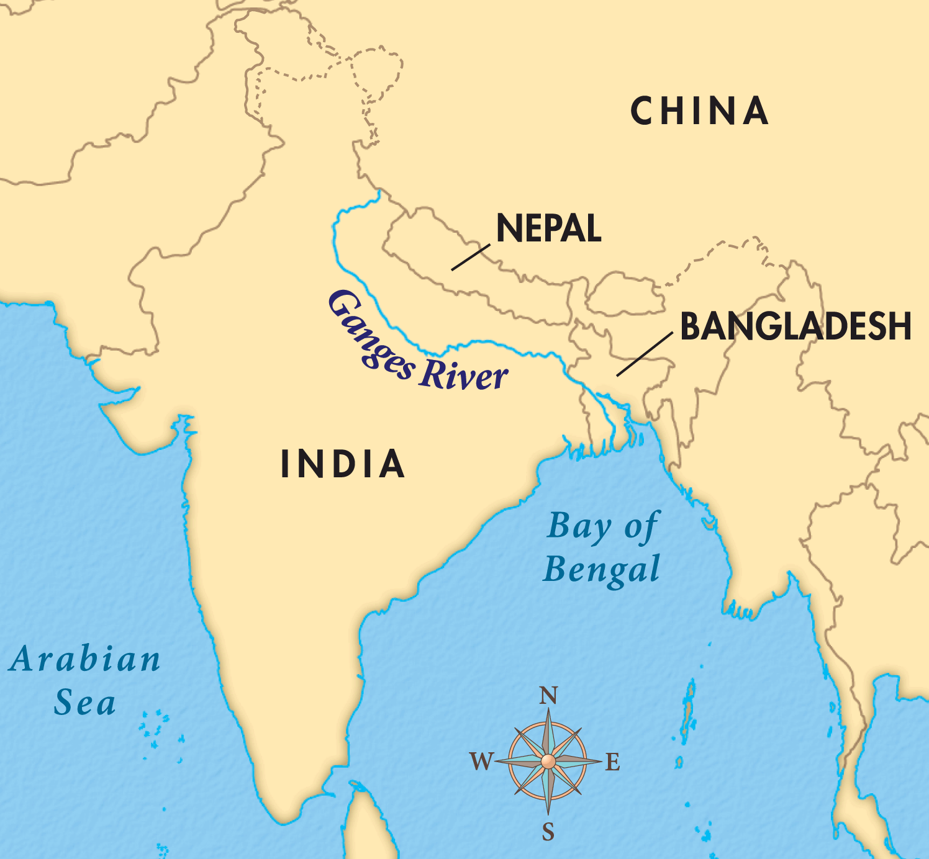
Pollution of the Ganga
The Ganga runs its course of over 2500 km from Gangotri in the Himalayas to Ganga Sagar in the Bay of Bengal.

Slide 6
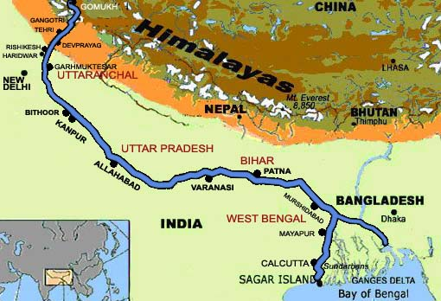
Pollution of the Ganga
It is being turned into a drain by more than a hundred towns and cities in Uttar Pradesh, Bihar and West Bengal that pour their garbage and excreta into it.

Slide 7
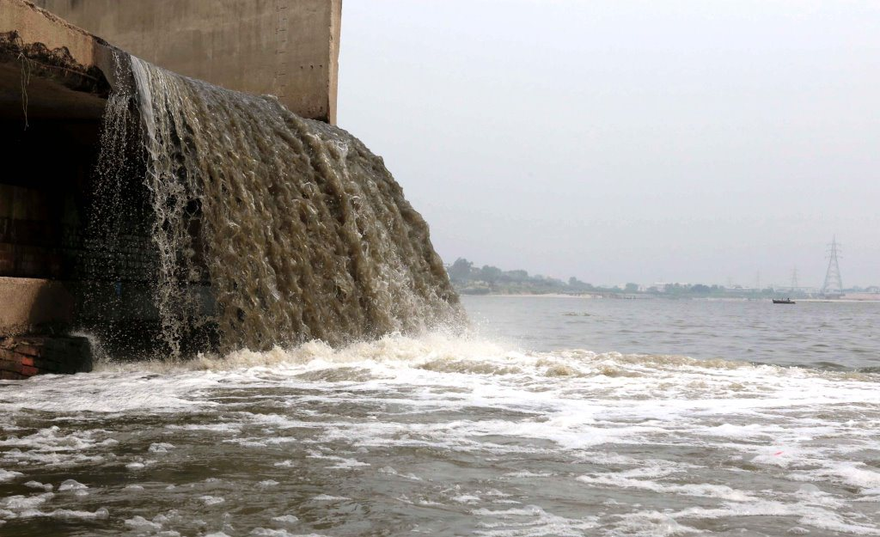
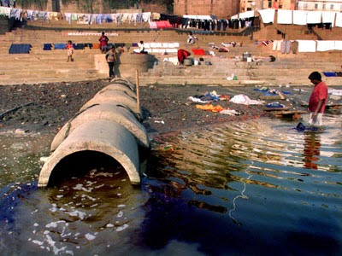
Pollution of the Ganga
Largely untreated sewage is dumped into the Ganges every day.

Slide 8
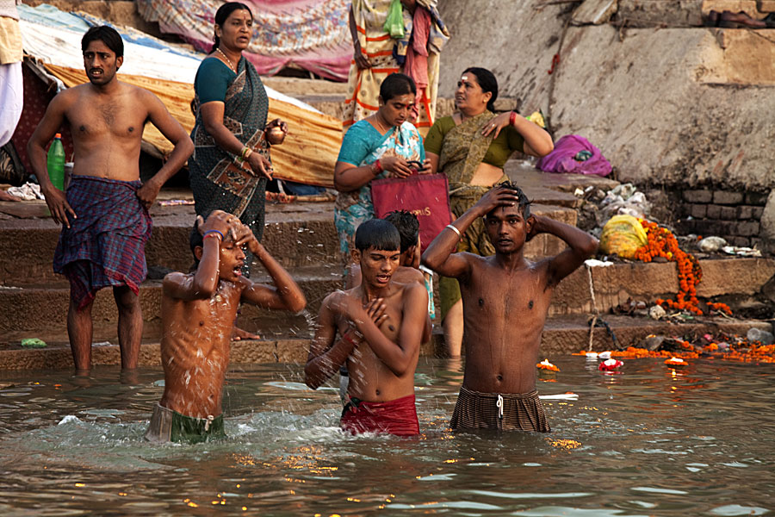
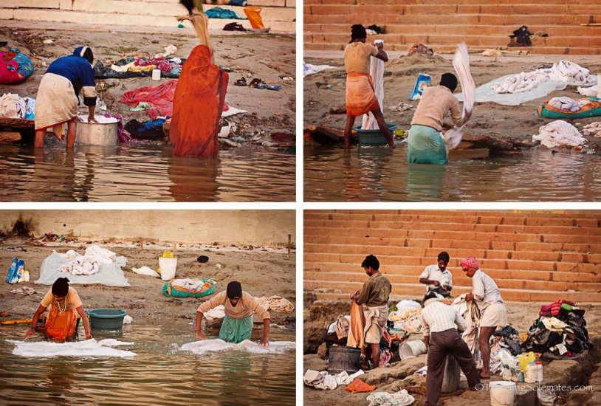
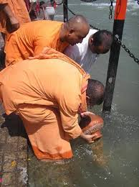
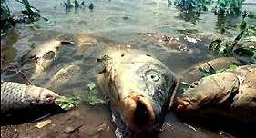
Pollution of the Ganga
In addition, think of the pollution caused by other human activities like bathing, washing of clothes and immersion of ashes or unburnt corpses.
And then, industries contribute chemical effluents to the Ganga’s pollution load and the toxicity kills fish in large sections of the river.

Slide 9

But we need not feel powerless or overwhelmed by the scale of the problems because there are many things we can do to make a difference.

Slide 10
Thank You

